Slide 1
Visual-Textual Prompt learning
2023/04/07
By Dandan Guo
CLIP->COOP->COCOOP->DeFo->PLOT

Slide 2
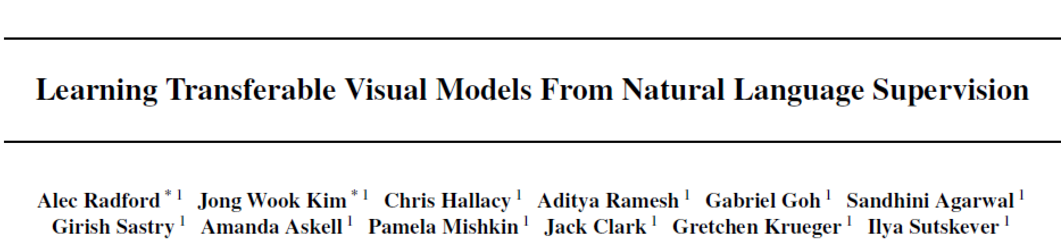
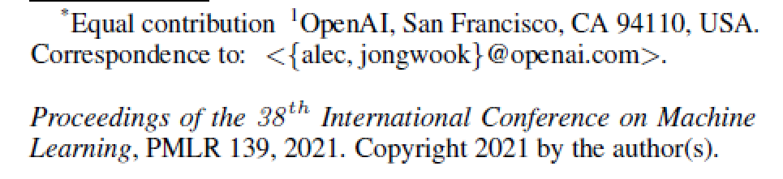
CLIP
Citations: 4.4K

Slide 3
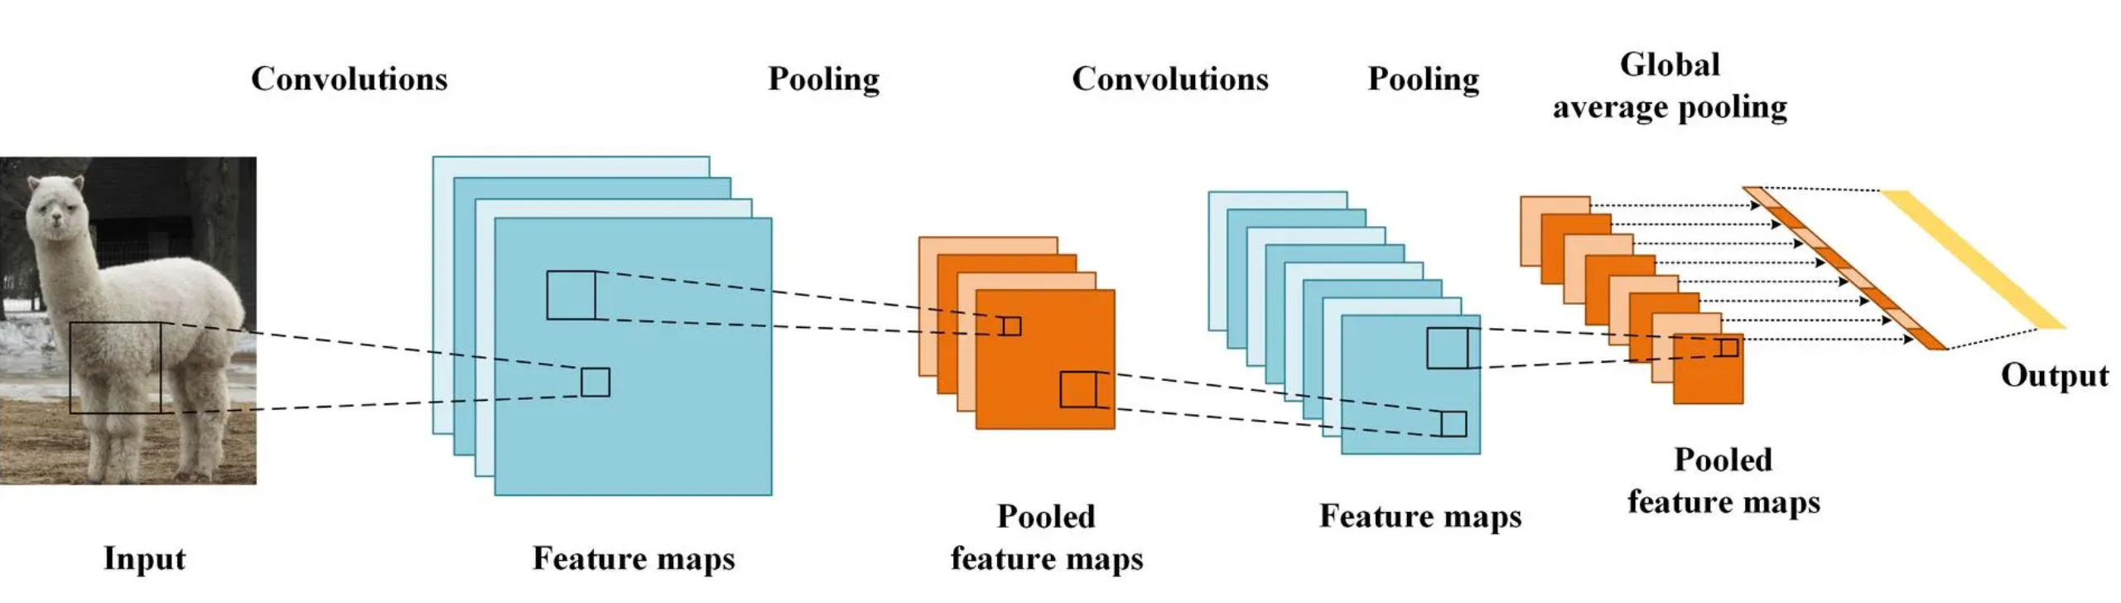
Common visual recognition systems
Pre-train models on crowd-labeled datasets such as ImageNet
Although training categories often have a textual form, such as “goldfish” or “toilet paper,” they will be converted into discrete labels just for easing the computation of the cross-entropy loss, leaving the semantics encapsulated in texts largely unexploited.
Limits visual recognition systems to closed-set visual concepts, making them unable to deal with new categories since additional data are required for learning a new classifier.

Slide 4
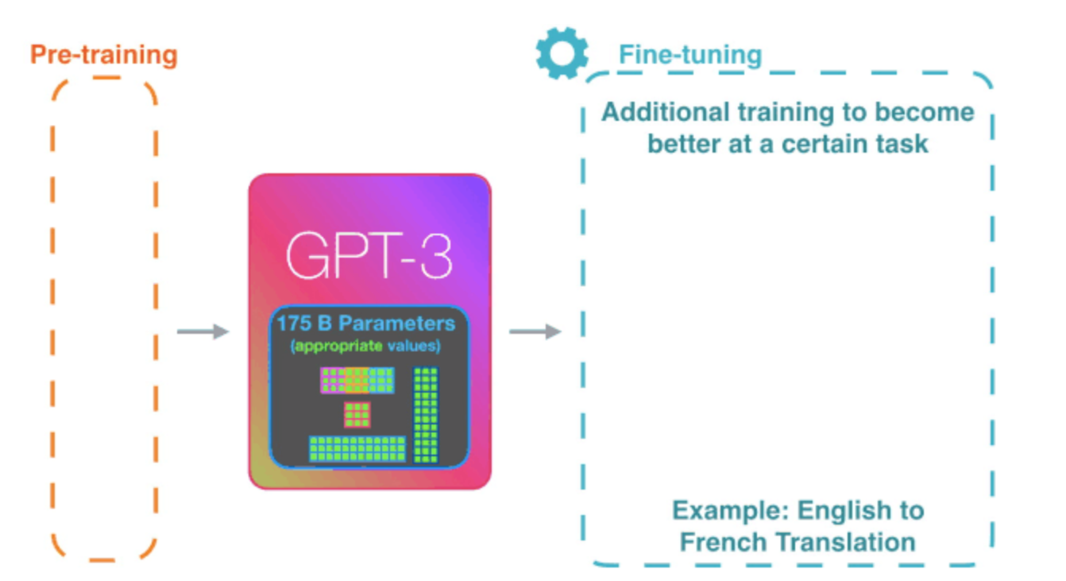
Pre-train models for CV and NLP
Pre-training methods which learn directly from raw text have revolutionized NLP over the last few years.
zero shot transfer to downstream datasets.
suggest that the modern pre-training methods within web-scale collections of text surpasses that of high-quality crowd-labeled NLP datasets.
Could scalable pre-training methods which learn directly from web text result in a similar breakthrough in computer vision?
A major motivation for natural language supervision is the large quantities of data of this form available publicly on the internet.

Slide 5
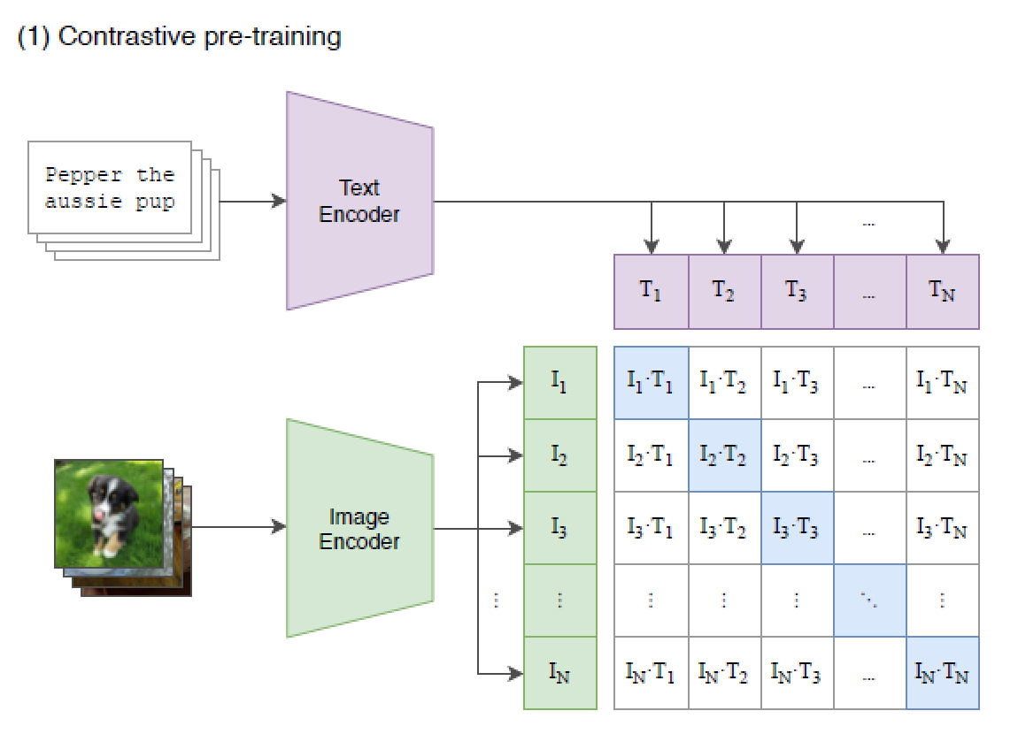
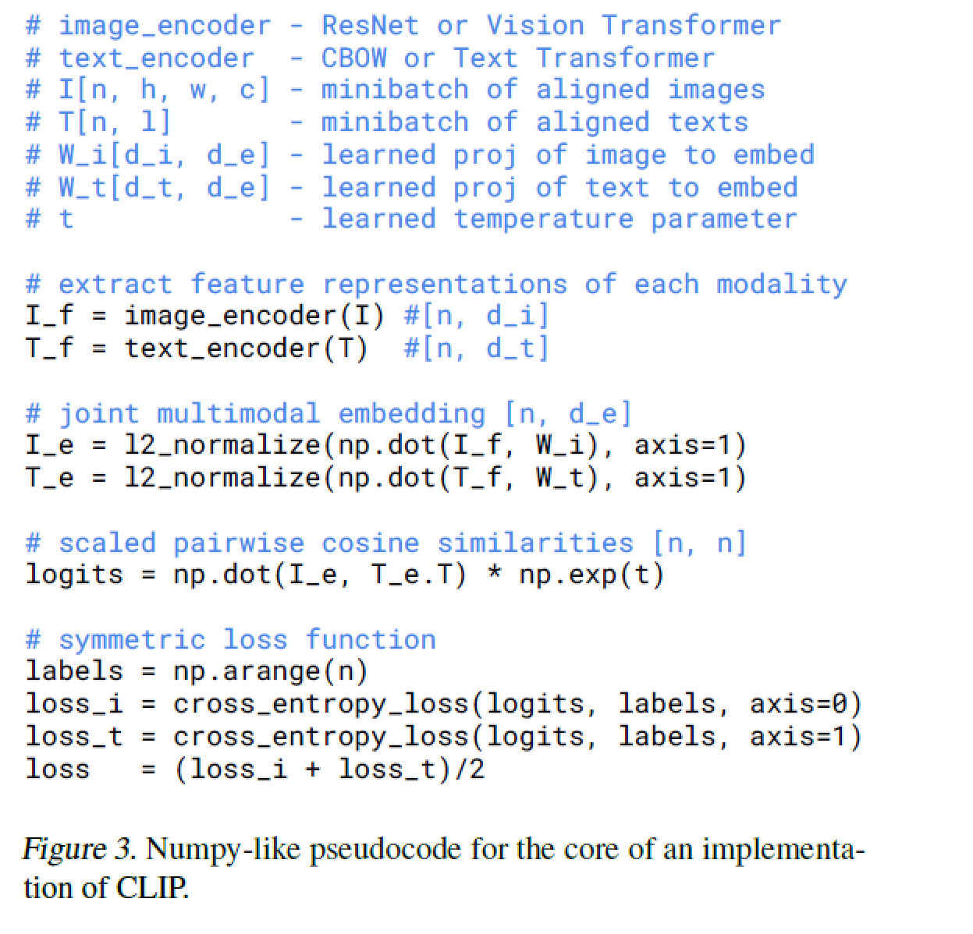
Approach
Creating a Sufficiently Large Dataset
constructed a new dataset of 400 million (image, text) pairs collected form a variety of publicly available sources on the Internet.
Selecting an Efficient Pre-Training Method：Contrastive Language-Image Pre-training （CLIP）
jointly training an image encoder and text encoder to maximize the cosine similarity of the image and text embeddings of the N real pairs in the batch while minimizing the cosine similarity of the embeddings of the N*N-N incorrect pairings.

Slide 6
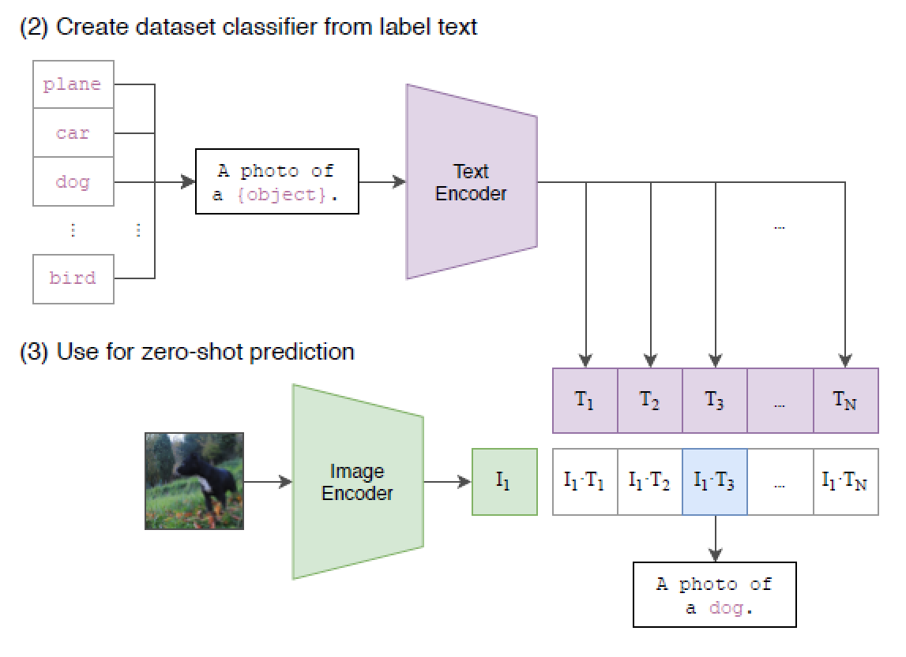
Approach
Using CLIP
For each dataset, we use the names of all the classes in the dataset as the set of potential text pairings and predict the most probable (image, text) pair according to CLIP
prompting

Slide 7
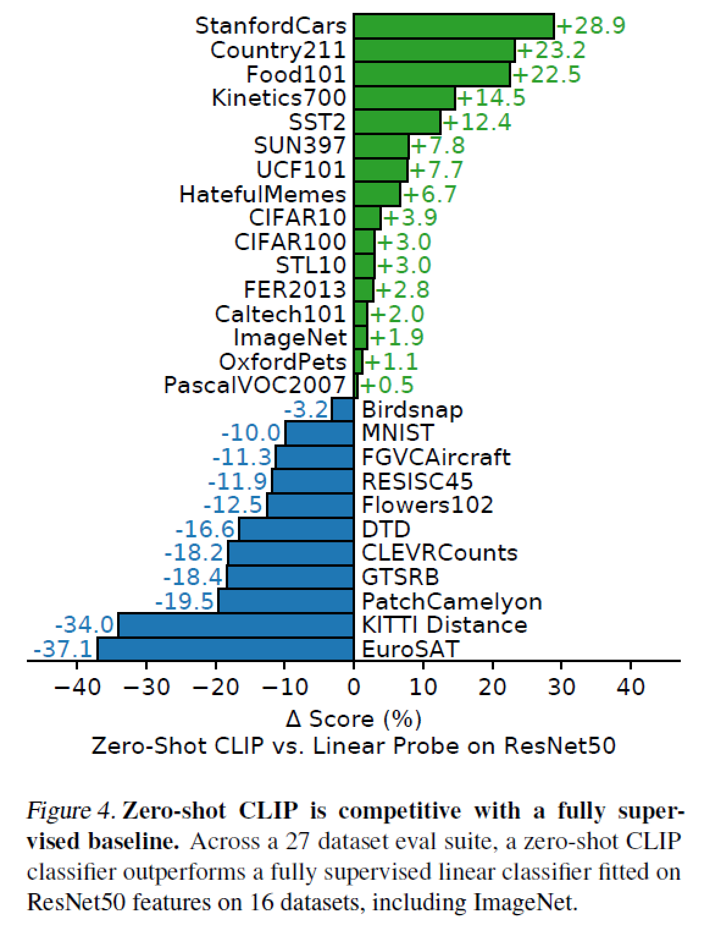
Zero-Shot Performance
baseline: fitting a fully supervised, regularized, logistic regression classifier on the features of the canonical ResNet50.
Zero-shot CLIP outperforms this baseline slightly and wins
on 16 of the 27 datasets.
zero-shot CLIP is quite weak on several specialized, complex, or abstract tasks such as satellite image classification (EuroSAT and RESISC45), lymph node tumor detection (PatchCamelyon), counting objects in synthetic scenes (CLEVRCounts), self-driving related tasks such as German traffic sign recognition (GTSRB), recognizing distance to the nearest car (KITTI Distance). These results highlight the poor capability of zero-shot CLIP on more
complex tasks.

Slide 8
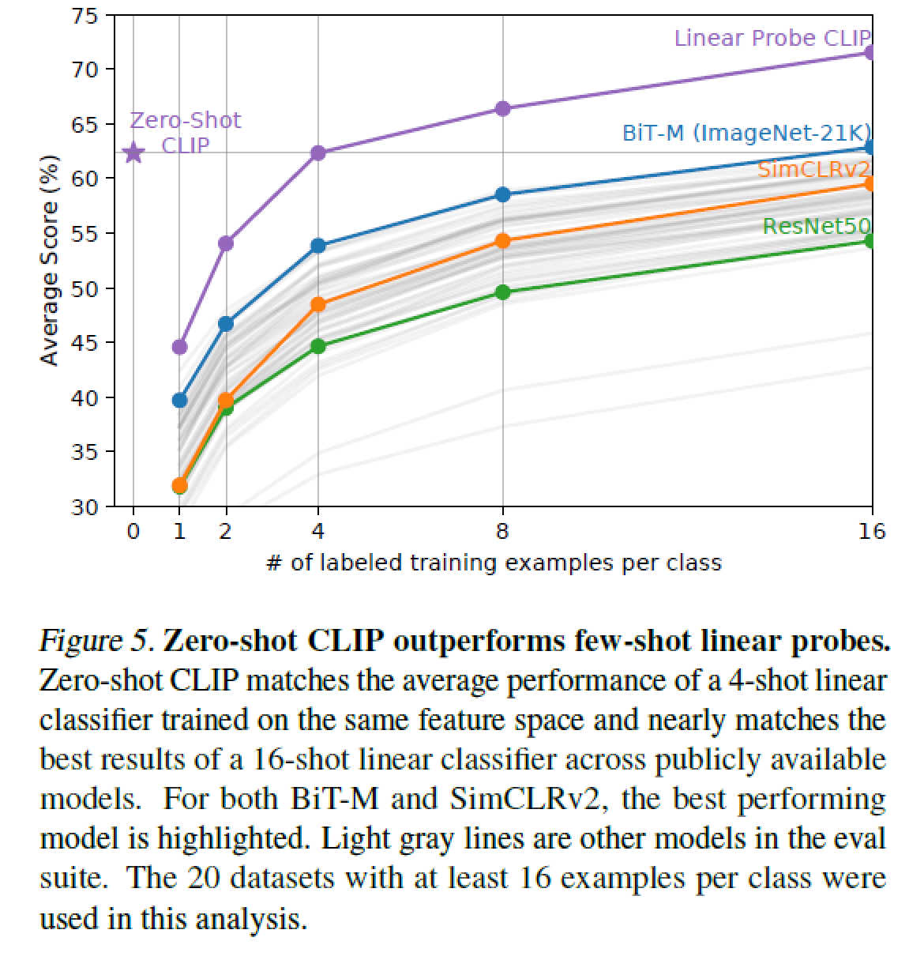
Zero-Shot Performance
Conclusion
are largely driven by advances in the following three areas:
i) text representation learning with Transformers
(Vaswani et al., 2017),
ii) large-minibatch contrastive representation learning (Chen et al., 2020; He et al., 2020; Hénaff et al., 2020),
iii) web-scale training datasets—CLIP benefits from 400 million curated image text pairs.

Slide 9
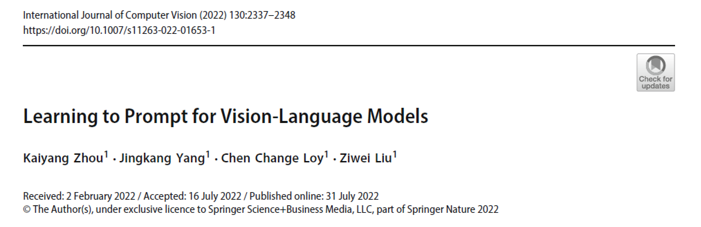

Citations: 300+

Slide 10
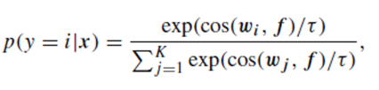

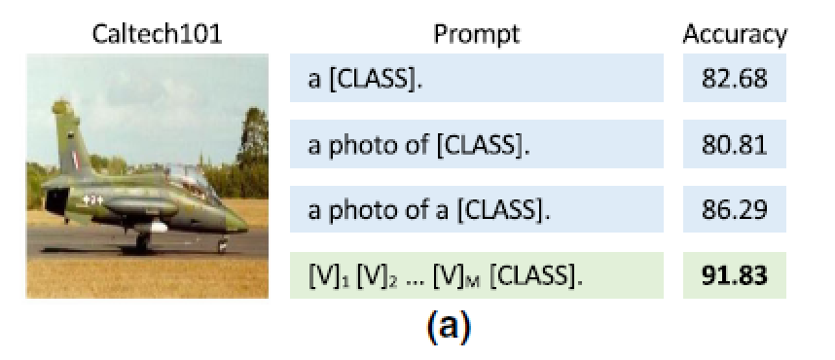
vision-language pre-training aligns images and texts in a common feature space, which allows zero-shot transfer to a downstream task.
the text input, known as prompt, plays a key role in downstream datasets.
a slight change in wording could make a huge difference in performance

Slide 11
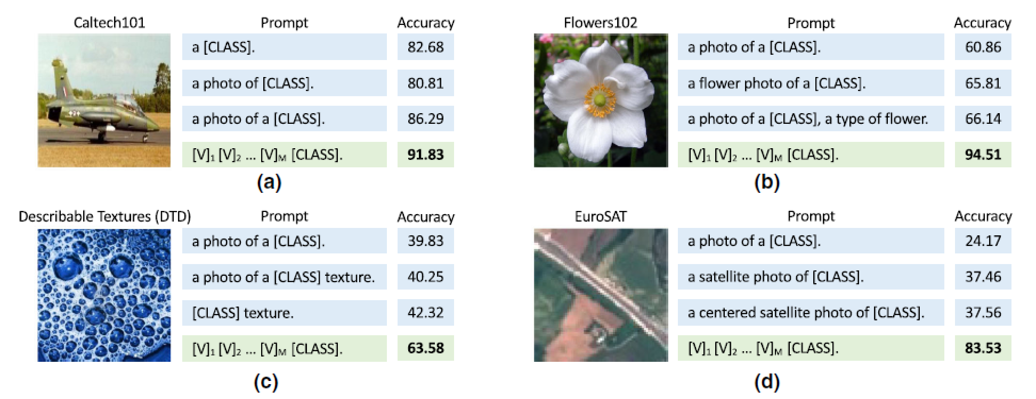
Moreover, prompt engineering also requires prior knowledge about the task and ideally the language model’s underlying mechanism.
This is exemplified in Figure 1(b-d) where adding task-relevant context can lead to significant improvements, i.e., “flower” for Flowers102, “texture” for DTD and “satellite” for EuroSAT.

Slide 12
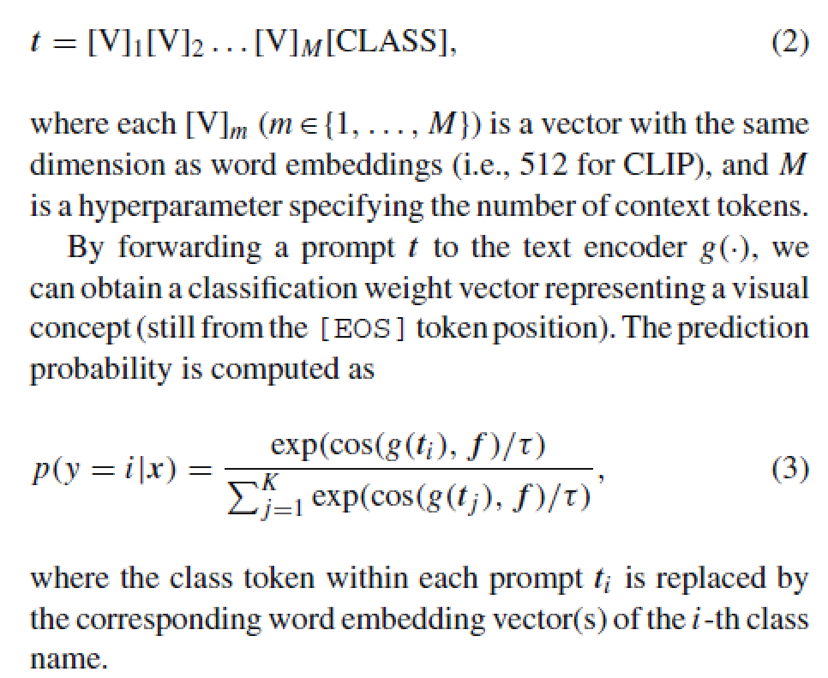

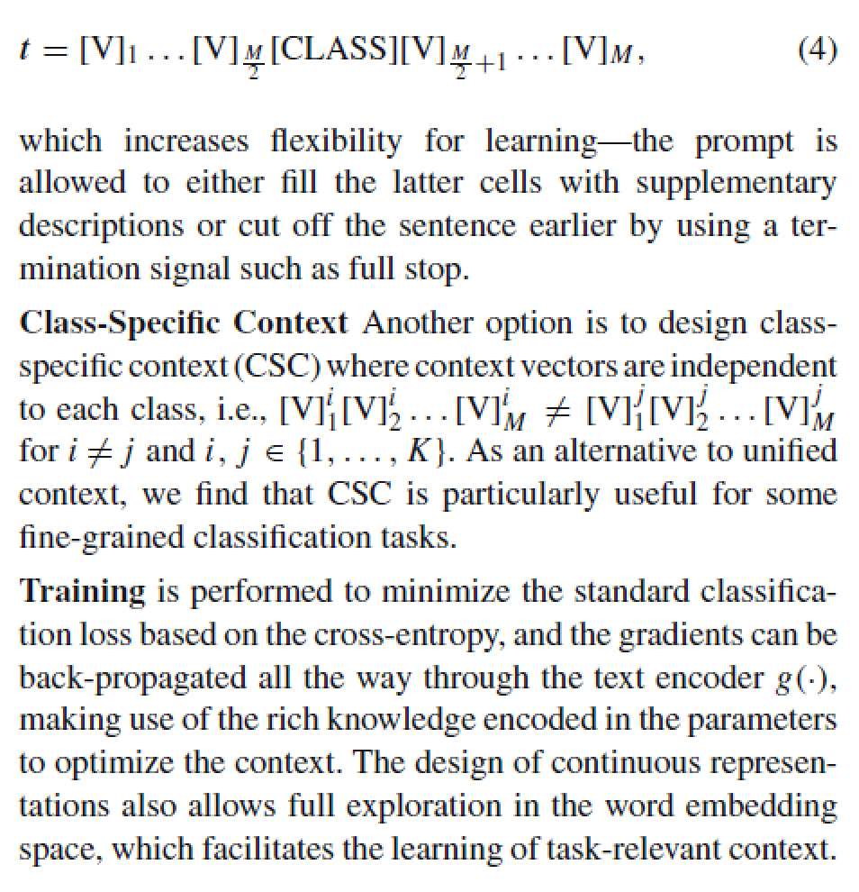
Context Optimization (CoOp)
modeling context words with continuous vectors that are end-to-end learned from data while the massive pre-trained parameters are frozen, avoiding manual prompt tuning.
Unified Context
Class-Specific Context
particularly useful for some fine-grained classification tasks
Training
minimize the standard classification loss, and the gradients can be back-propagated through the text encoder g(·), making use of the rich knowledge encoded in the parameters to optimize the context.
The design of continuous representations also allows full exploration in the word embedding space, which facilitates the learning of task-relevant context.

Slide 13
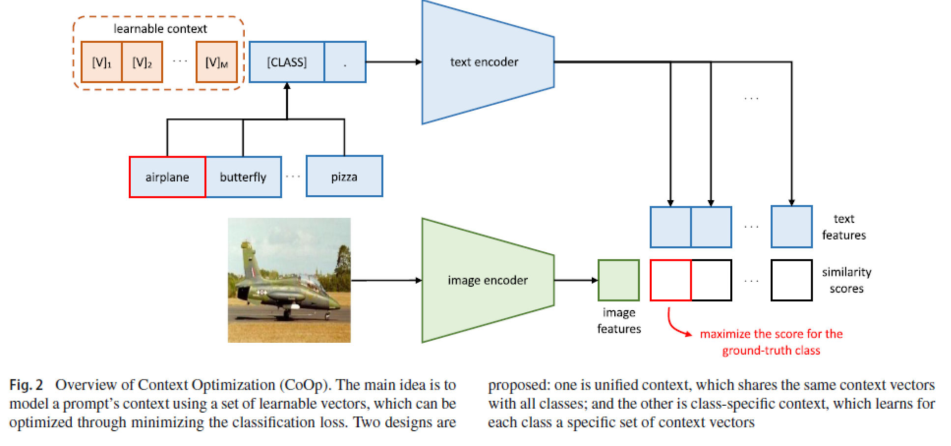
Context Optimization (CoOp)

Slide 14
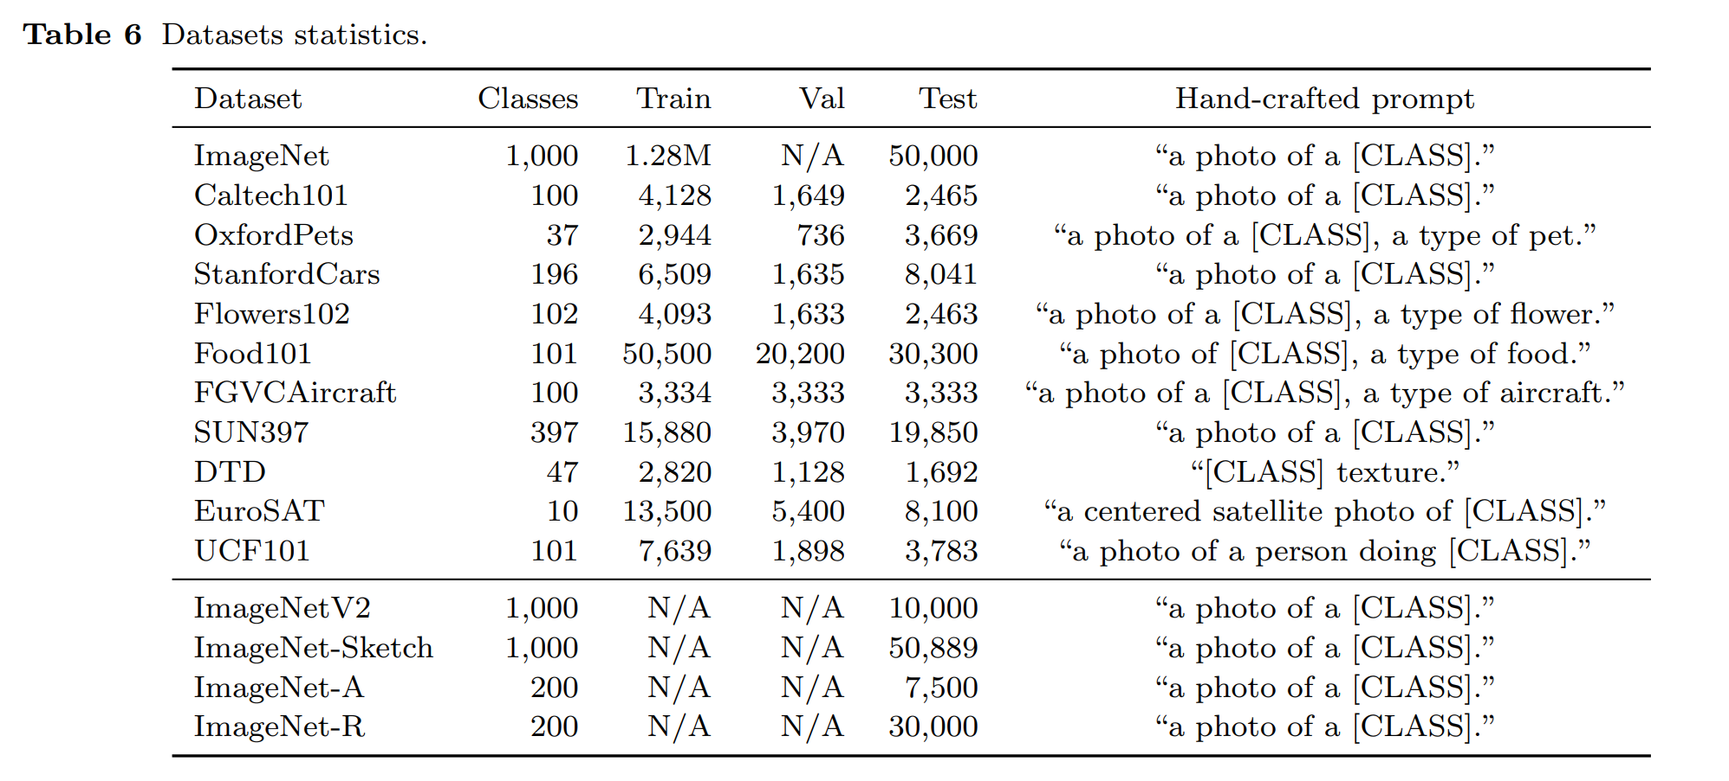
Few-Shot Learning

Slide 15
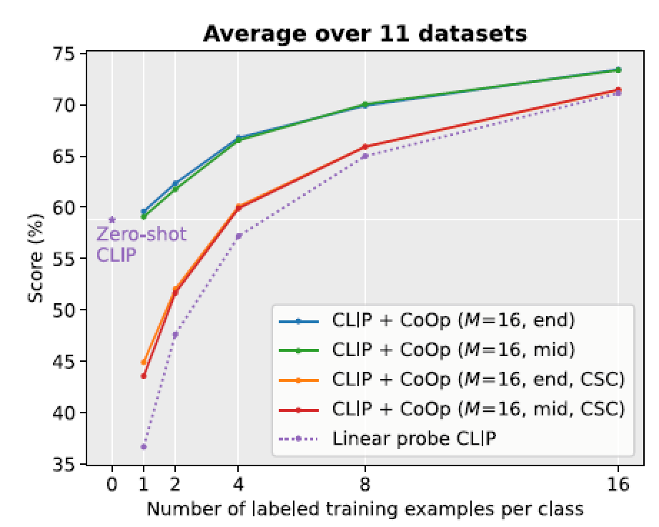
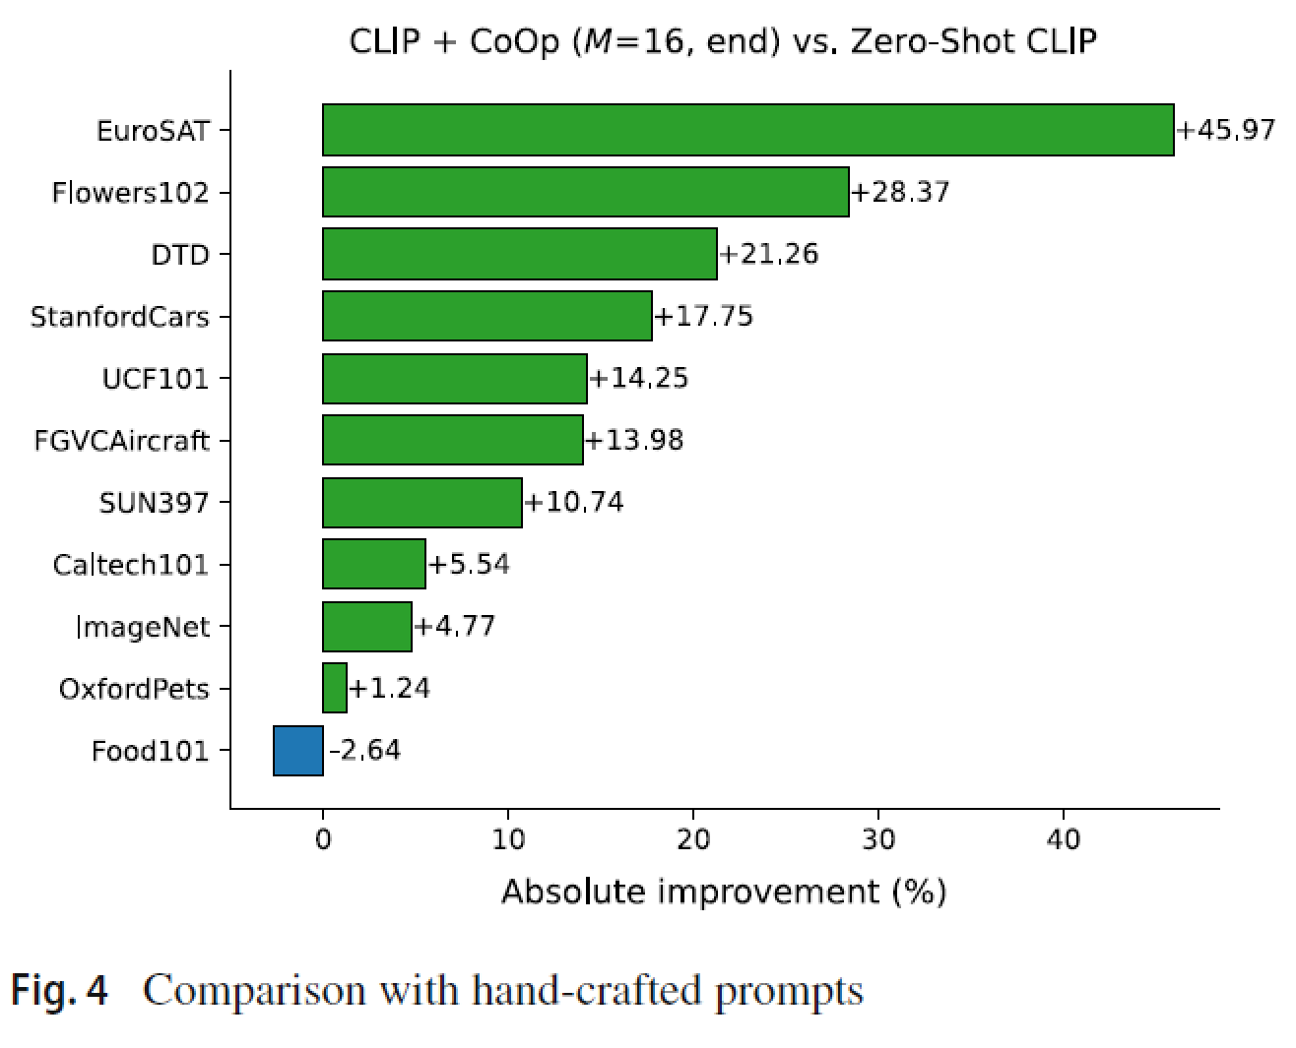
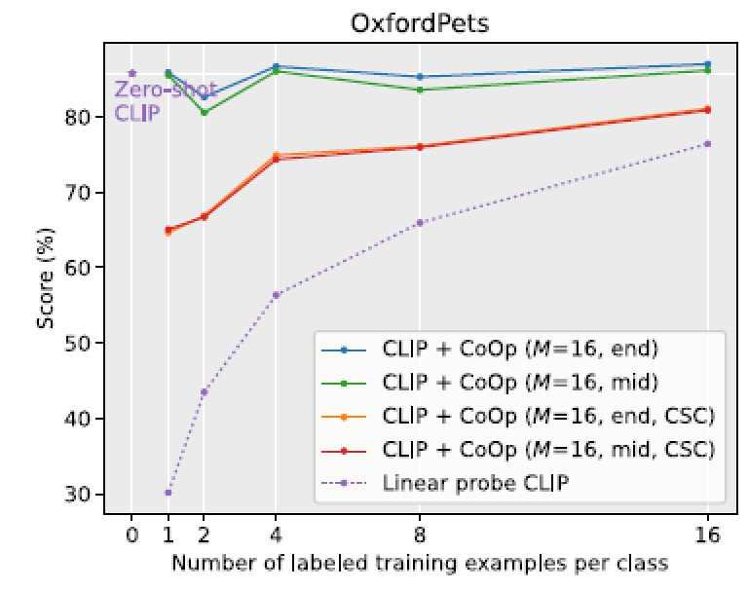
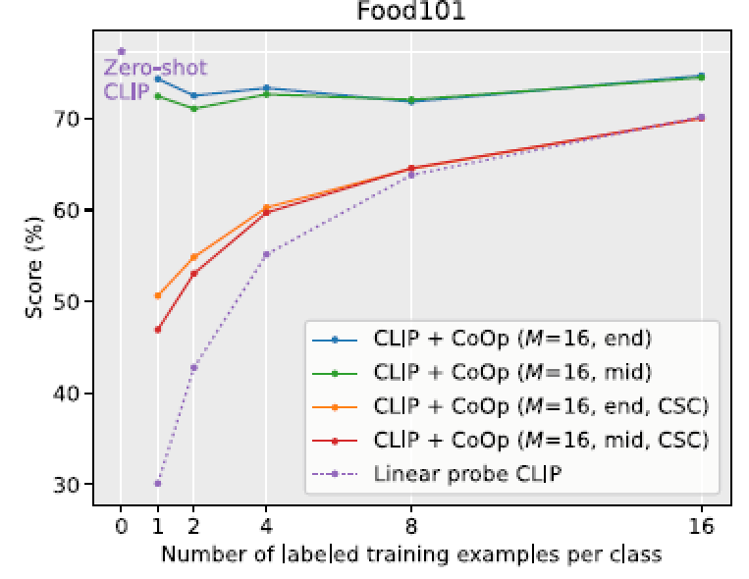
CLIP+CoOp is a strong few-shot learner
Huge improvements are observed on specialized tasks namely EuroSAT and DTD
seemingly an overfitting problem. A potential solution is to impose higher regularization like increasing the weight decay

Slide 16
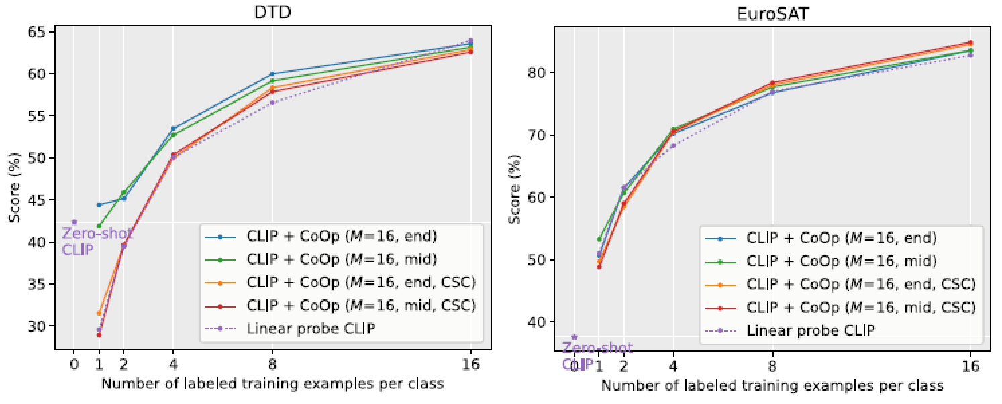
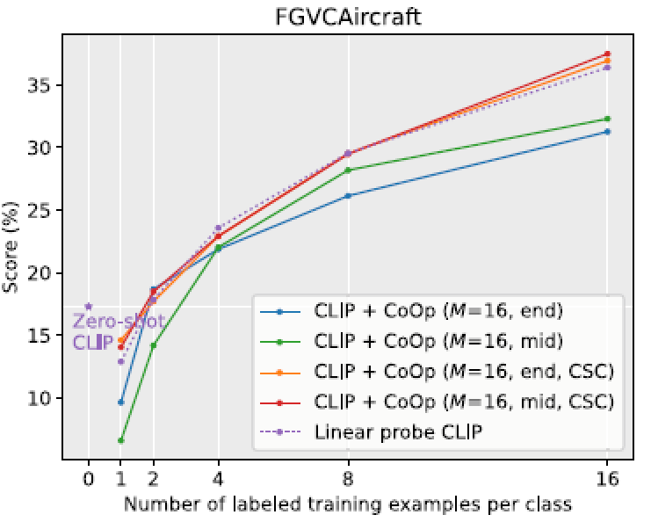
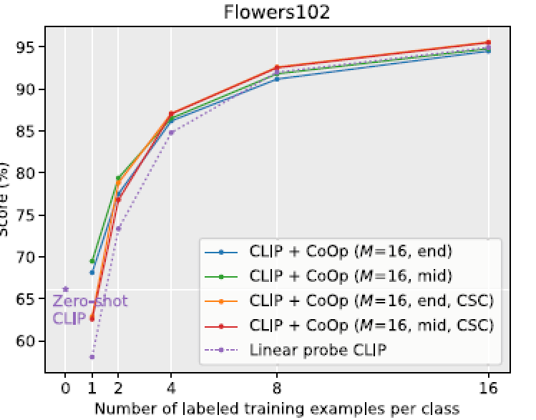
Comparison with Linear Probe CLIP
CLIP+CoOp demonstrates clear advantages over the linear probe model
suggesting that CoOp is much more effective than learning a linear classifier from scratch for few-shot learning
linear probe model is comparable to CLIP+CoOp on the two specialized tasks / fine-grained datasets
CoOp’s CSC version can beat the linear probe CLIP

Slide 17
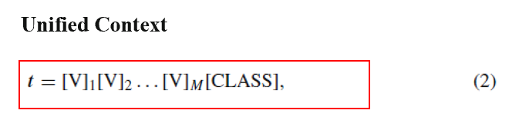
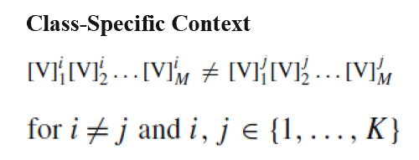
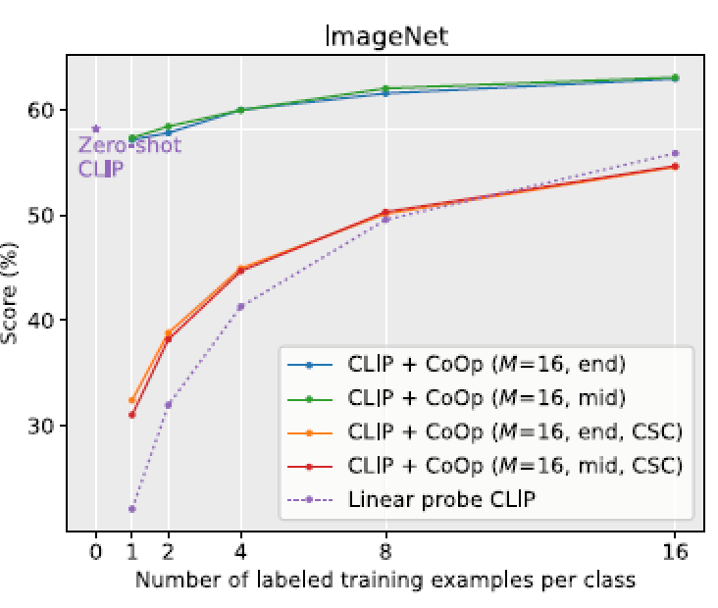
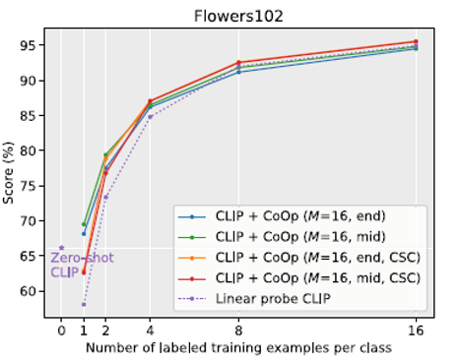
Unified vs Class-Specific Context
On average, using unified context leads to better performance.
CSC mostly underperforms unified context in challenging low-data scenarios (fewer than 8 shots

Slide 18
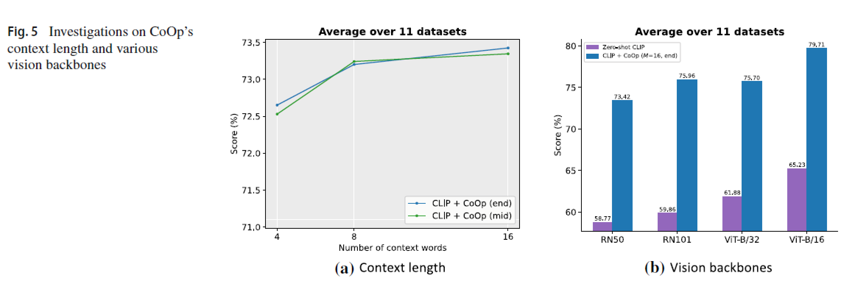
Context Length
performance and that positioning the class token in the middle gains more momentum with longer context length.
The results are expected: the more advanced the backbone, the better the performance. The gap between CoOp and hand-crafted prompts is significant across all architectures.

Slide 19
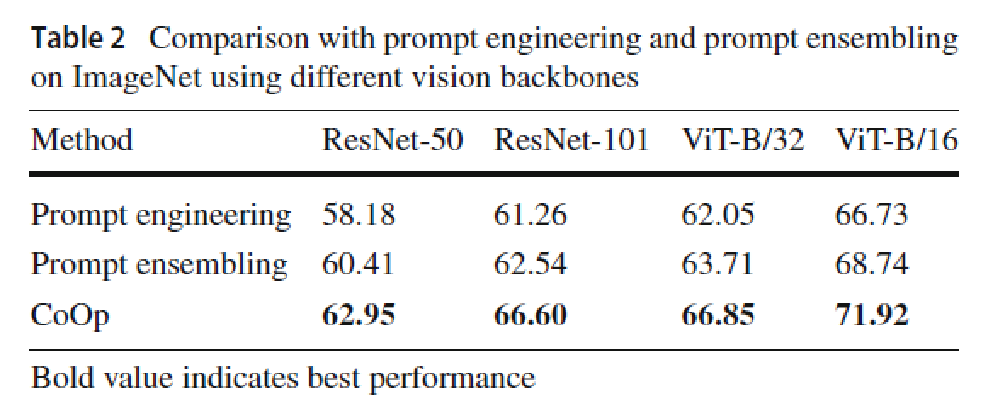
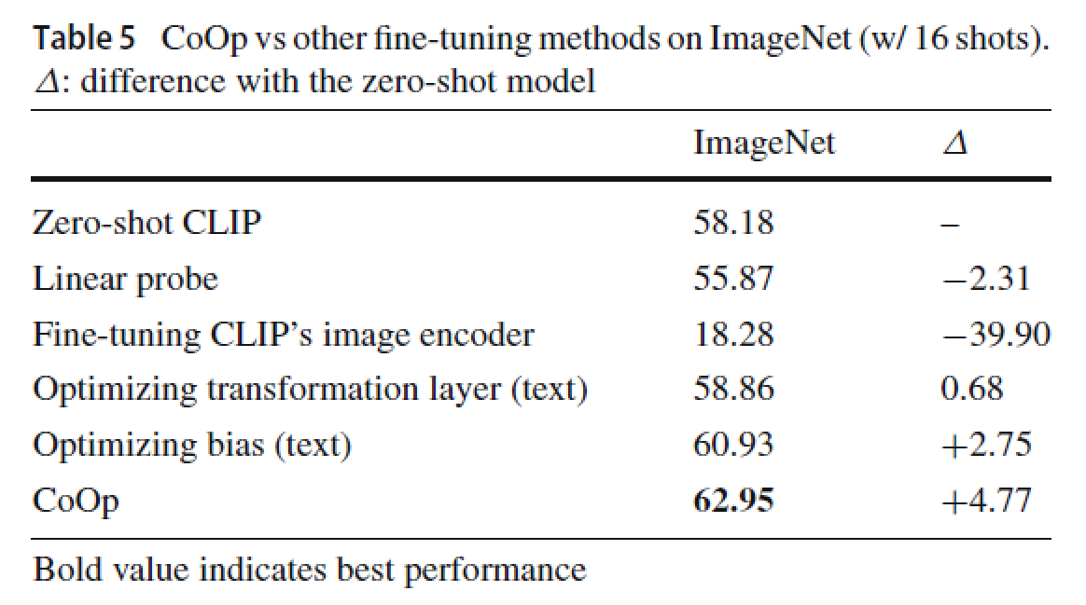
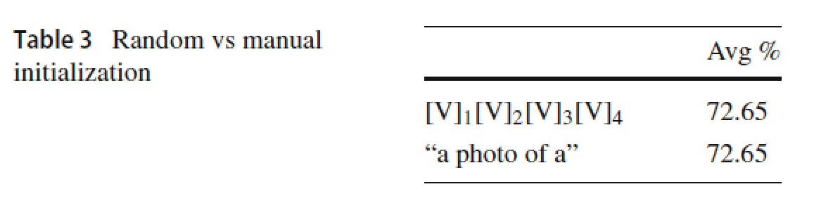
Comparison with Prompt Ensembling/ Initialization/Fine-tuning Methods
The authors of CLIP have suggested that additional improvements can be obtained by ensembling over multiple zero-shot classifiers generated using different hand-crafted prompts
“a photo of the large [CLASS].”
“a bad photo of the [CLASS].”
“a origami [CLASS].”

Slide 20

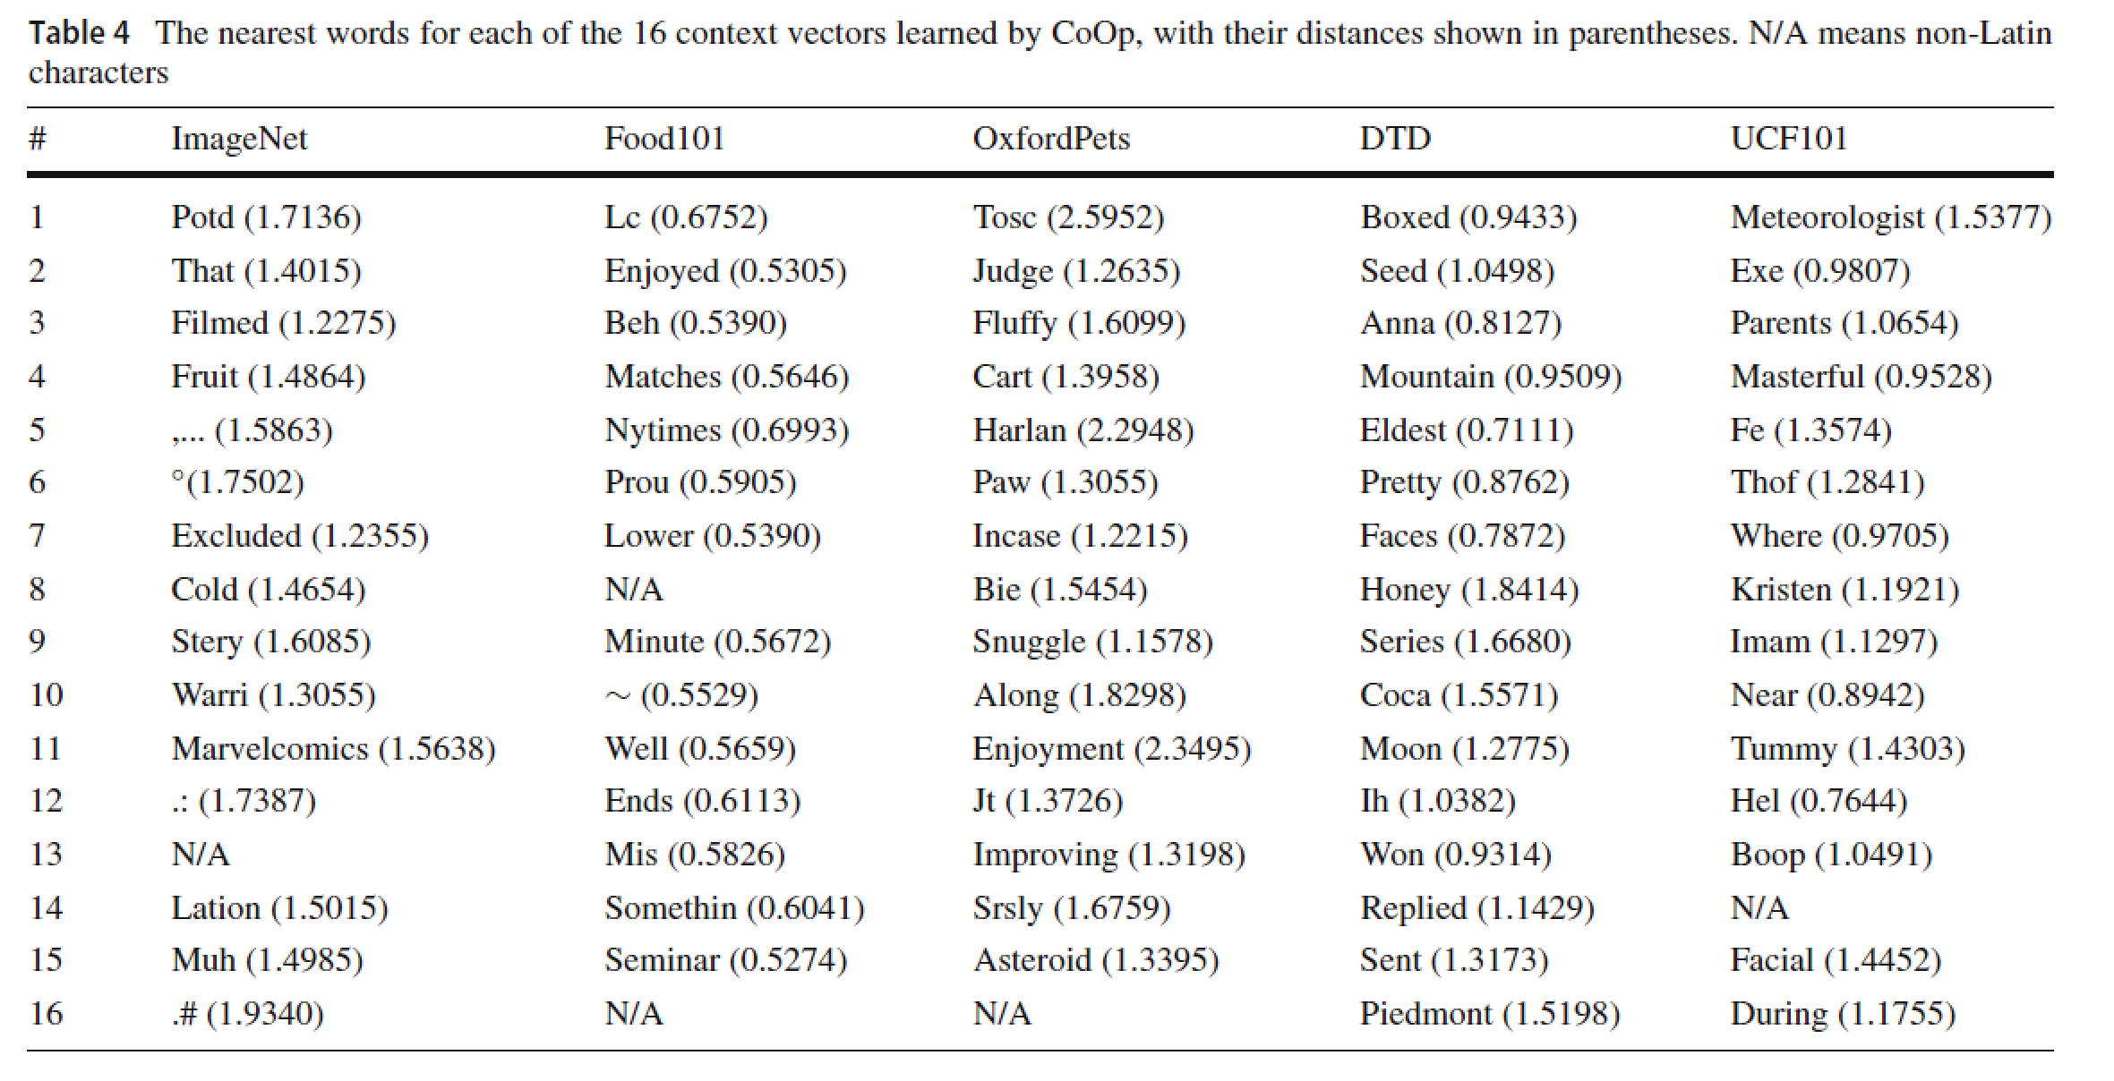
Interpreting the Learned Prompts
Overall, we are unable to draw any firm conclusion based on the observations because using nearest words to interpret the learned prompts could be inaccurate—the semantics of the vectors is not necessarily correlated with the nearest words.

Slide 21

Citations:140+

Slide 22
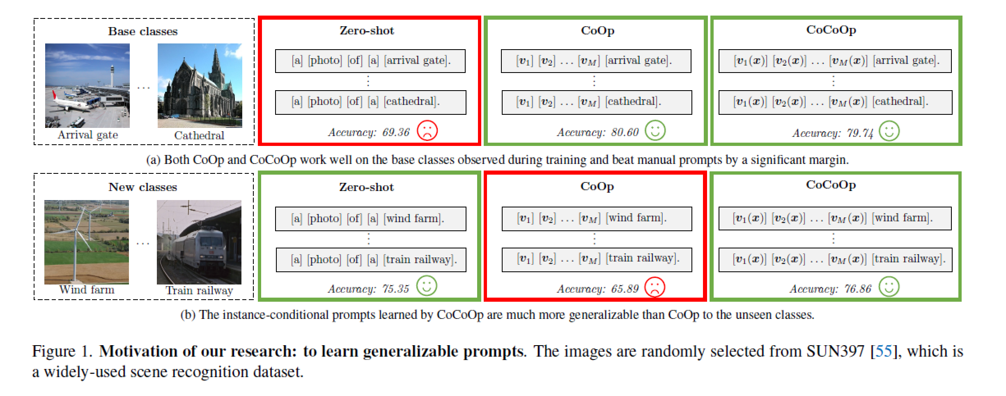
The context learned by CoOp works well in distinguishing the base classes but suffers a significant drop in accuracy when it is transferred to the new (unseen) classes,—even though the task’s nature remains the same, i.e., recognizing scenes.
The results suggest that the learned context overfits the base classes, thus failing to capture more generalizable elements that are vital for broader scene recognition.

Slide 23

a photo of a [CLASS]
We argue that such a problem is caused by CoOp’s static design: the context, which is fixed once learned, is optimized only for a specific set of (training) classes. On the contrary, the manually-designed prompts adopted by the zero-shot method are relatively generalizable.

Slide 24
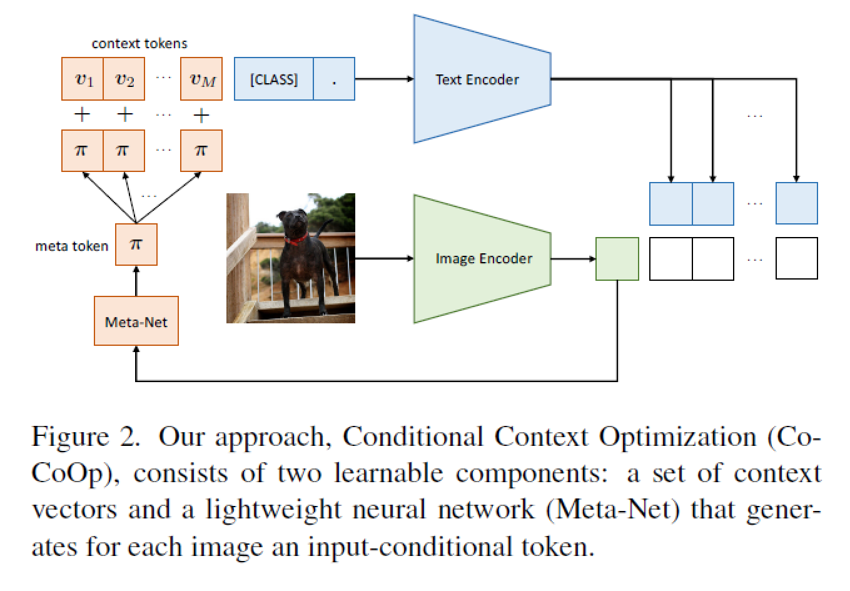
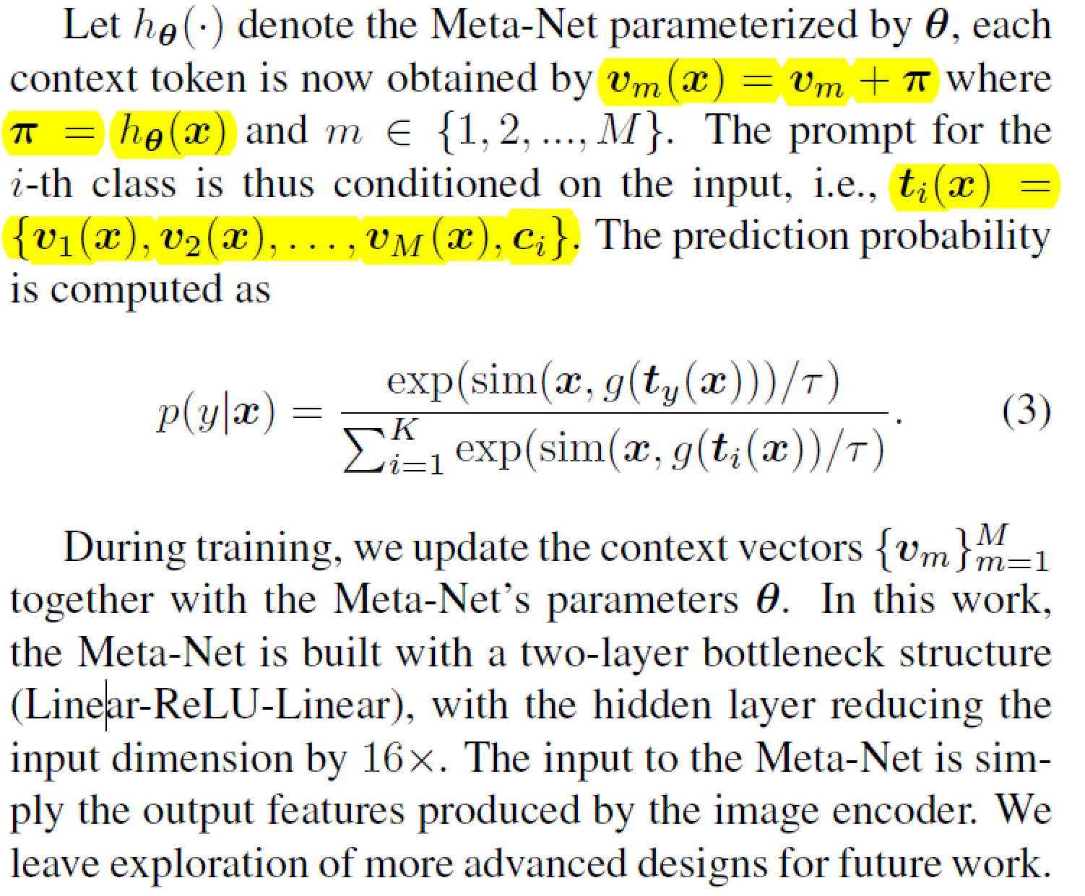
CoCoOp: Conditional Context Optimization

Slide 25
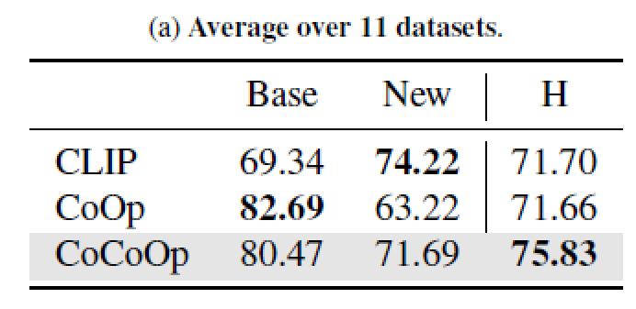
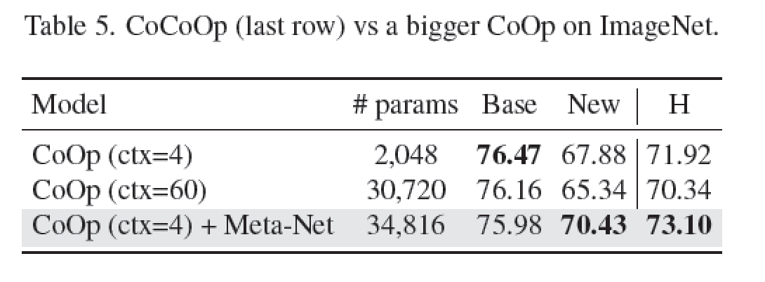
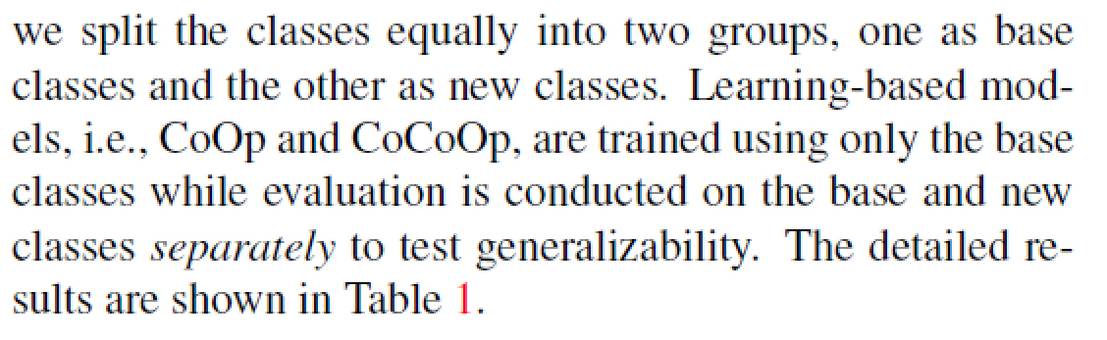
The first limitation is about training efficiency: CoCoOp requires for each image an independent forward pass of instance-specific prompts through the text encoder. CoOp only needs a single forward pass of prompts through the text encoder for an entire mini-batch of any size.
The second limitation is that on 7 out of the 11 datasets， CoCoOp’s performance in unseen classes still lags behind CLIP’s

Slide 26
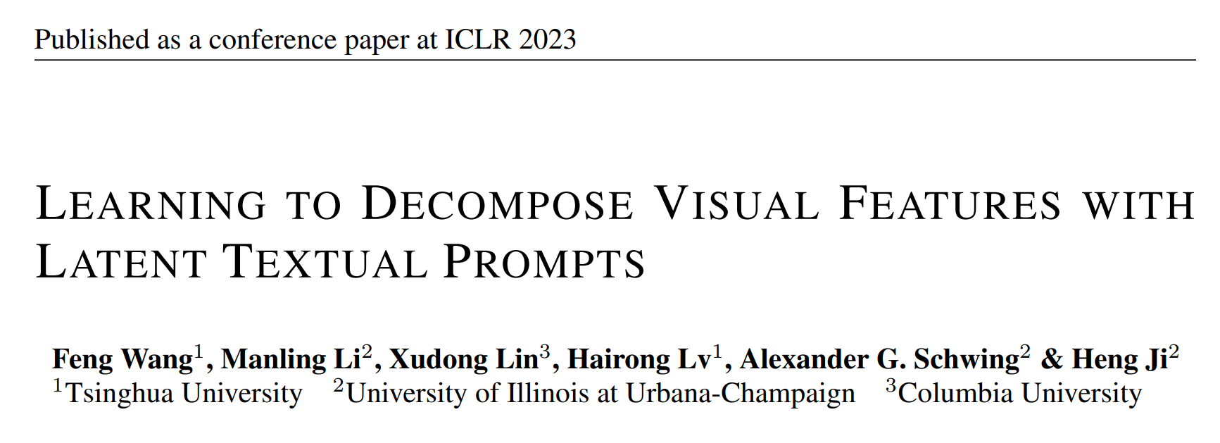

Slide 27
Hard textual targets：the class names
CLIP
CoOp
CoCoOp
Expressive sensitivity ：class names in text prompts (e.g., “airplane” or “automobile”), do not permit to accurately summarize the semantic information of an image.
Fore example, for zero-shot inference on CIFAR-10 (Krizhevsky et al., 2009), CLIP obtains an accuracy of 63.7% when the original class names are used.
Notably, simply replacing or extending the class names with suitable synonyms1 (e.g., “plane” and “car” rather than “airplane” and “automobile”) can improve accuracy to 79.6%.

Slide 28
Hard textual targets：the class names
Conceptual sensitivity：despite the fact that hundreds of millions of pretraining samples cover a large number of concepts that can possibly appear in downstream datasets, zero-shot inference continues to struggle to recognize rare objects..
For example, zero-shot CLIP is only 38.5% accurate when classifying EuroSAT satellite images, which is much lower than the result of a supervised ResNet-50 encoder (93.4%).
Also, zero-shot CLIP with a ResNet-50 encoder achieves less than 90% accuracy on MNIST which can even be outperformed by a simple logistic regression model.

Slide 29
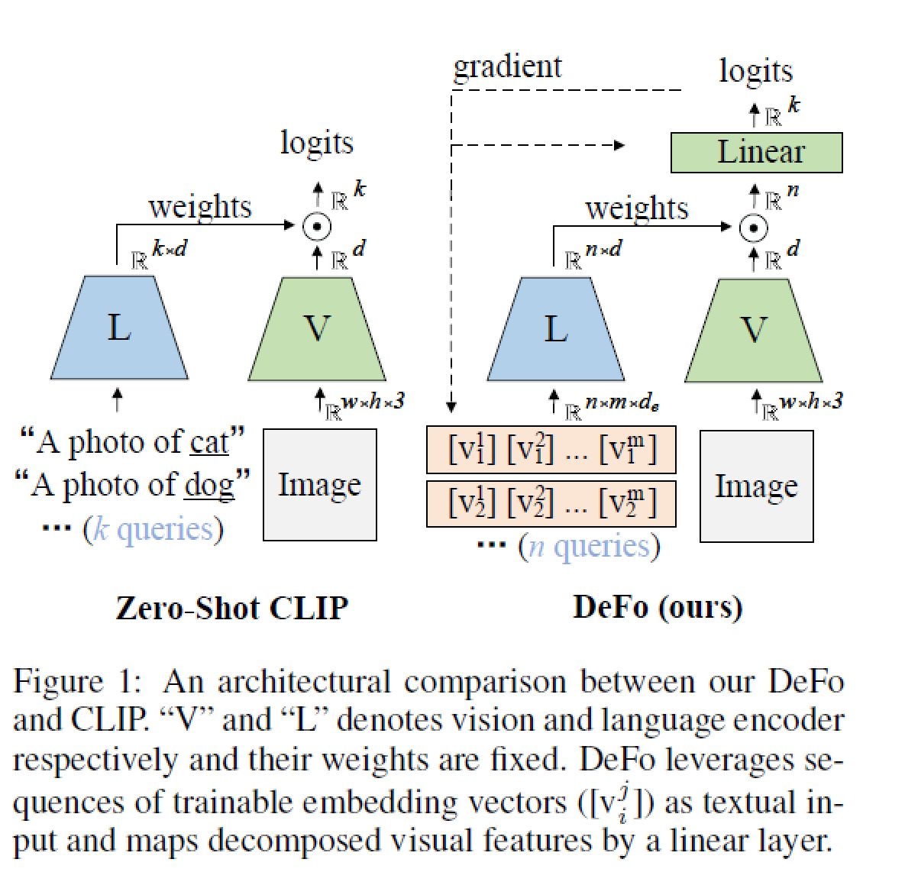
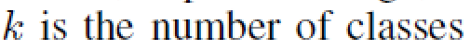
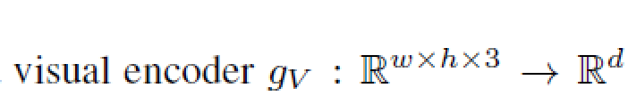
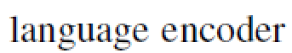
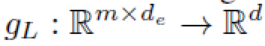
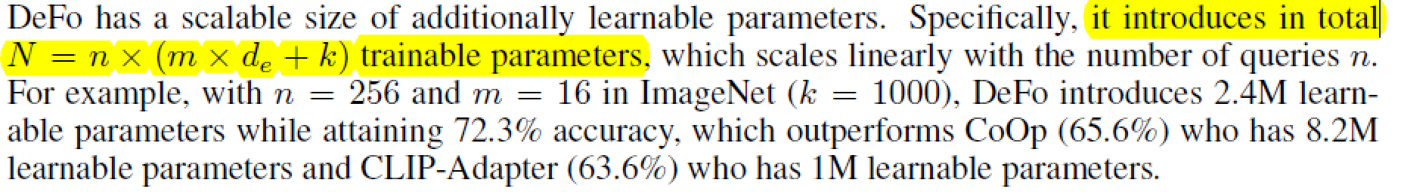
Decomposed Feature Prompting (DeFo)

Slide 30
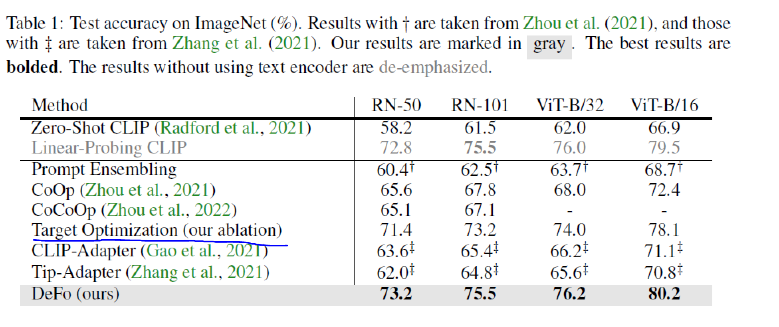
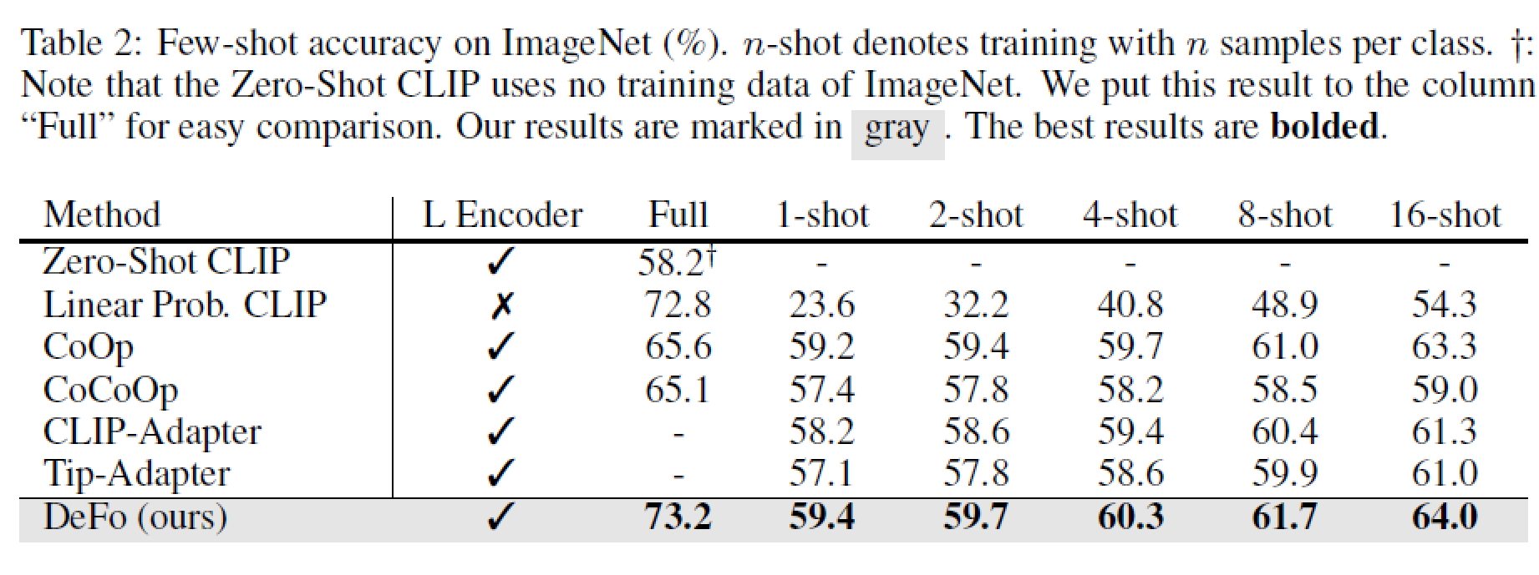
DeFo makes CLIP-like vision-language models free from both hand-crafted prompts and annotations such as class names. In this way we address the issues of expressive and conceptual sensitivity caused by using class names as hard targets.
Target Optimization: uses learnable embedding vectors as class names combined with a hand-crafted prompt prefix.

Slide 31
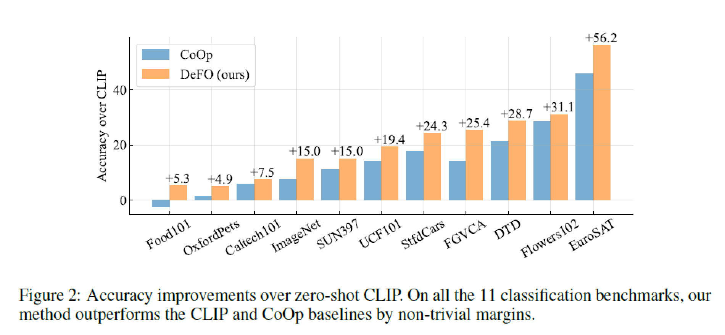
CLIP favors the common and generic objects such as the images in Food101, OxfordPets, and Caltech101.
However, when it comes to fine-grained feature recognition tasks such as classifying the type of aircraft (Maji et al., 2013), CLIP and CoOp are shown to be very sensitive to the objects.
The different robustness between CLIP and DeFo indicates the issue of sensitivity challenge for CLIP, and indicates that DeFo successfully addresses this issue by decomposing and then combining the visual features.

Slide 32
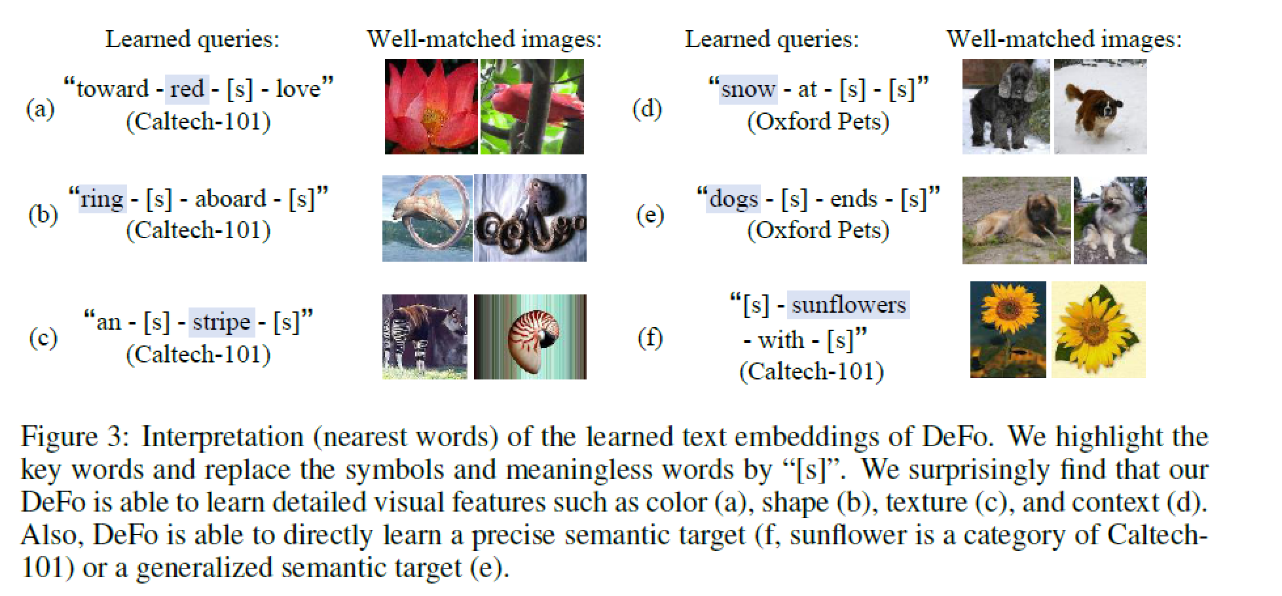
INTERPRETATION OF TEXT QUERIES

Slide 33


Slide 34


Slide 35

It motivates us to learn multiple prompts to comprehensively represent the class and thus facilitate classification.

Slide 36





Slide 37


